Slide 1
Deep Embedded Clustering-Based Semantic User Grouping for UAV-Assisted Disaster Communication
MACHINE LEARNING · 25SC2107E · FINAL REVIEW
TEAM
UNDER THE GUIDANCE OF
Chandrakanth 2520040098
Mr. N Lava Prasad
Pavan Karthik 2520040071
Assistant Professor, Department of ECE
Karthik 2520040047
KL University · A.Y. 2026–27
Notes:
Introduce the team and the guide. This project groups disaster-affected users by what they are asking for and how urgent it is, so that a future UAV communication system can serve them in a sensible order. The whole report is built on an unsupervised pipeline: K-Means and DBSCAN as baselines, and Deep Embedded Clustering as the proposed method.

Slide 2
Problem and motivation
When a disaster takes down ground networks, limited capacity should not treat every request the same way.
OBJECTIVES
1
Prepare 1,000 user records as a ten-feature input matrix
2
Compare K-Means, DBSCAN and Deep Embedded Clustering
General
Medical
General information
Medical assistance
3
Interpret four groups from their average characteristics
Location
Rescue
Location sharing
Rescue coordination
4
Provide new-user group prediction and a Streamlit dashboard
Deep Embedded Clustering · UAV disaster communication
2
Notes:
Floods and earthquakes damage cellular towers and power, so networks fail or get overloaded. People then ask for different things: general information, medical help, sharing a location, or rescue. A UAV can act as a temporary base station, but its capacity is limited, so we first need to organise users into meaningful groups. Our objectives: prepare the data, compare three clustering methods, interpret the four groups, and provide a prediction workflow with a dashboard. We do not claim a live drone network or improved survival outcomes.

Slide 3
Dataset and feature preparation
Field | Type | Preparation
user_id | Identifier | Dropped
x_coordinate, y_coordinate | Numerical | Standardized
channel_condition | Numerical | Standardized
emergency_priority | Numerical | Standardized
delay_requirement | Numerical | Standardized
semantic_similarity | Numerical | Standardized
requested_data_type | Categorical | One-hot (4 columns)
1,000
synthetic user records with eight raw columns
10
input features: six standardized numbers plus four one-hot categories
Processed matrix: 1,000 × 10
Deep Embedded Clustering · UAV disaster communication
3
Notes:
The dataset has 1,000 users and eight raw columns. user_id is only an identifier, so it is removed. The six numerical features (x and y coordinates, channel condition, emergency priority, delay requirement, semantic similarity) are standardized to mean 0 and standard deviation 1, so no feature dominates distance calculations because of its units. The requested data type is categorical, so it is one-hot encoded into General, Medical, Location and Rescue columns. That gives 6 + 4 = 10 features per user. Be upfront that all 1,000 records are synthetic.

Slide 4

Workflow and technologies
01
02
03
04
Prepare
Cluster
Evaluate
Present
Drop user_id, standardize six numerical features and one-hot encode the data type into a 1,000 × 10 matrix.
Run K-Means (k = 4) and DBSCAN as baselines, then Deep Embedded Clustering as the proposed method.
Silhouette, Davies–Bouldin and Calinski–Harabasz scores, plus average-based group profiles.
Predict a group for a new user and explore all results in a Streamlit dashboard.
Python 3.10
TensorFlow / Keras
Scikit-learn
Streamlit
run_all.py executes the complete workflow from a single entry point.
Deep Embedded Clustering · UAV disaster communication
4
Notes:
The pipeline has four stages: prepare the data, cluster it, evaluate the results, and present them. Preprocessing and clustering are modular Python scripts under a src folder, with data and results folders alongside. TensorFlow and Keras implement the autoencoder and DEC, scikit-learn provides preprocessing plus the K-Means and DBSCAN baselines, and Streamlit gives the dashboard. run_all.py runs everything in one go. Source code is on GitHub (link on the last slide).

Slide 5
Deep Embedded Clustering
10
32
16
5
input features
neurons, encoder layer 1
neurons, encoder layer 2
latent dimensions used for clustering
1
2
3
4
Train the autoencoder on the ten input features
Initialize four cluster centers in the latent space with K-Means
Compute soft assignments and a sharpened target distribution
Refine the assignments by minimizing KL divergence
Deep Embedded Clustering · UAV disaster communication
5
Notes:
DEC is our proposed method. An autoencoder compresses the ten input features through a 32-neuron layer and a 16-neuron layer into a five-dimensional latent representation. K-Means initializes four cluster centers in that latent space. DEC then computes soft assignments (how likely each user belongs to each cluster), builds a sharper target distribution that strengthens confident assignments, and refines the assignments by minimizing the KL divergence between the two. The aim is a representation where cluster structure is clearer than in the raw input space.

Slide 6
Model comparison
Method | Parameters | Clusters | Silhouette ↑ | Davies–Bouldin ↓ | Calinski–Harabasz ↑
K-Means | k = 4 | 4 | 0.6320 | 0.5501 | 2630.6143
DBSCAN | Grid search over eps and min_samples | 4 | 0.6320 | 0.5501 | 2630.6143
DEC (proposed) | Encoder 10 → 32 → 16 → 5 | 4 | 0.6320 | 0.5501 | 2630.6144
All three methods score almost the same, so this experiment does not show a DEC advantage.
Scores from the saved model_comparison.csv on the same synthetic dataset. Higher is better for silhouette and Calinski–Harabasz; lower is better for Davies–Bouldin.
Deep Embedded Clustering · UAV disaster communication
6
Notes:
All three methods produced four clusters on the same 1,000 synthetic users. Silhouette is 0.6320 and Davies–Bouldin is 0.5501 for every method, and Calinski–Harabasz differs only in the seventh digit (2630.6143 versus 2630.6144). A silhouette of 0.6320 suggests reasonably separated clusters, but the scores are effectively tied, so we cannot claim DEC beats the baselines. The report itself lists investigating the near-identical values as future work. DBSCAN ran a grid search over eps and min_samples, but the winning pair was not stored in the saved metrics.

Slide 7
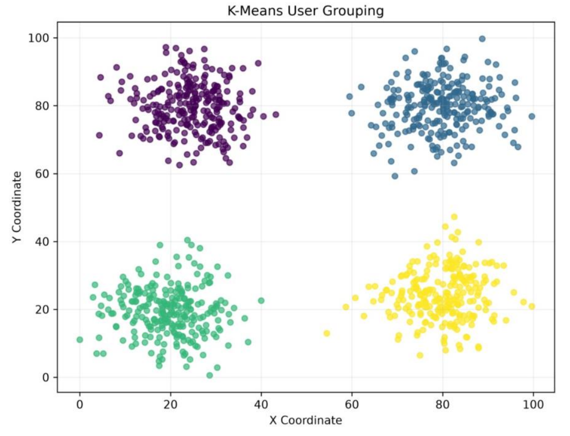
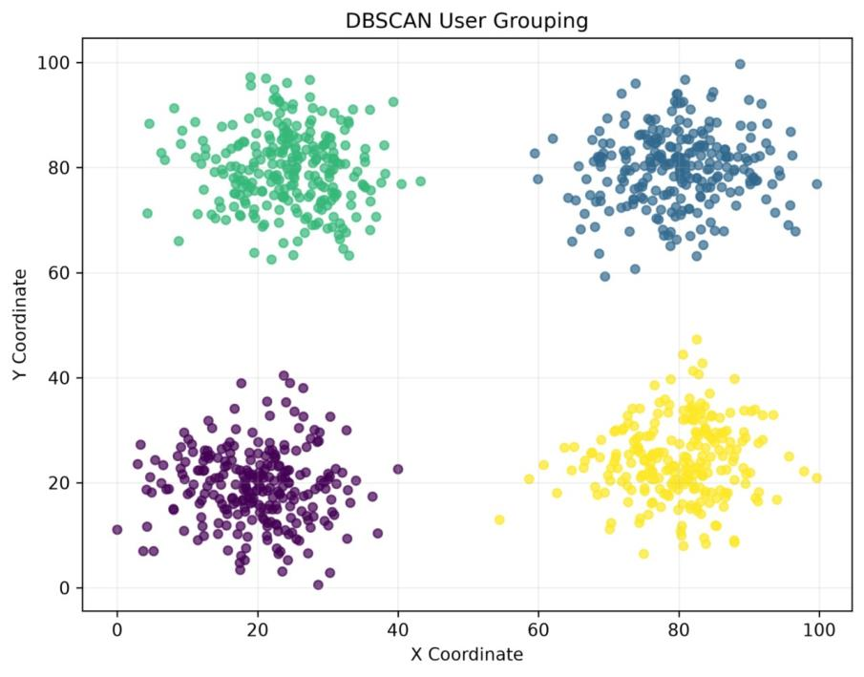
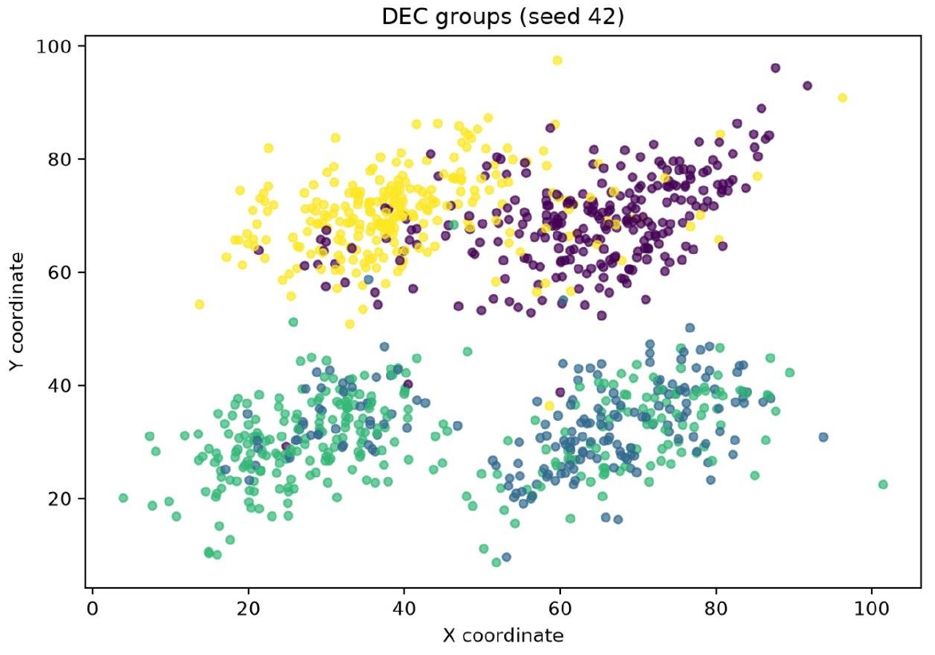
User groups in the coordinate plane
K-Means
DBSCAN
DEC
Four visibly separated groups
Four dense regions and zero noise points
Groups overlap more in this projection; the plot alone does not establish quality
Deep Embedded Clustering · UAV disaster communication
7
Notes:
These are Figures 6.1 to 6.3 from the report. K-Means and DBSCAN show four clean, separated regions in the x/y coordinate plane. The DEC plot (seed 42) shows the learned cluster labels for the displayed sample, and some groups overlap more in this projection. The report is explicit that this visual alone does not establish overall model quality. If asked why the DEC plot looks different from the first two: it is a different displayed sample and a different labelling, and the clusters are defined over all ten features, not just x and y.

Slide 8
Four DEC user groups
CLUSTER 0
CLUSTER 1
CLUSTER 2
CLUSTER 3
General
Medical
Location
Rescue
General information
Medical emergency
Location sharing
Rescue operation
253 users
253 users
256 users
238 users
Average priority
Average priority
Average priority
Average priority
1.21
Low
2.81
High
2.02
Medium
2.81
High
Average allowed delay
Average allowed delay
Average allowed delay
Average allowed delay
5.95 s
Flexible
0.98 s
Urgent
3.00 s
Medium
1.54 s
Urgent
Bar lengths show group averages: priority on a 0–3 scale, allowed delay on a 0–6 s scale.
Deep Embedded Clustering · UAV disaster communication
8
Notes:
Cluster IDs are just numbers, so we named each group after its dominant requested data type and its average characteristics. General: low priority (1.21) and the longest allowed delay (5.95 s). Medical: high priority (2.81) and the shortest delay (0.98 s). Location: medium priority (2.02) and medium delay (3.00 s). Rescue: high priority (2.81) and urgent delay (1.54 s), slightly more tolerant than Medical. Group sizes are close: 253, 253, 256 and 238 users. These profiles describe synthetic records and should be validated with emergency-response experts before any real use.

Slide 9
Limitations and threats to validity
Synthetic data
Tied scores
All 1,000 records are generated, so the group profiles cannot show how real disaster-affected users behave.
Silhouette, Davies–Bouldin and Calinski–Harabasz are near-identical, so no DEC advantage is demonstrated.
Sensitivity
No network test
Scores depend on scaling, model settings and initialization, and the winning DBSCAN parameters were not stored.
Internal clustering scores do not measure UAV network performance, and no live drone test is reported.
Deep Embedded Clustering · UAV disaster communication
9
Notes:
Be direct about the limits; it makes the review stronger. First, the data is synthetic, so the profiles are not validated representations of real disaster-affected people. Second, the three methods are effectively tied, so the results support the usefulness of organizing requests but do not prove DEC outperforms simpler clustering. Third, the scores depend on scaling, settings and initialization, and the saved metrics do not record which DBSCAN parameters won. Fourth, these are internal clustering scores and not a test of UAV network performance. Privacy also matters in a real deployment: location and emergency information are sensitive and need access limits and human oversight.

Slide 10
Conclusion and future work
CONCLUSION
FUTURE WORK
An end-to-end workflow groups 1,000 users into General, Medical, Location and Rescue.
Test on larger, real disaster datasets
Tune DEC and check stability across random seeds
Medical and Rescue are the most urgent groups; General tolerates the longest delay.
Validate groups with disaster-response experts
K-Means, DBSCAN and DEC score almost identically, so a DEC advantage is not shown.
Evaluate in a UAV network simulator
Add privacy, security and human oversight
Thank you. Questions are welcome.
Code: github.com/chandu235363/semantic-uav-disaster-communication
10
Notes:
Summary: we built an unsupervised pipeline that prepares ten features for 1,000 users, runs K-Means, DBSCAN and DEC, and interprets four groups: General, Medical, Location and Rescue. Medical and Rescue are the most urgent. The honest result is that the three methods score almost the same, so we have not shown DEC to be better. Next steps are real data, systematic tuning and stability checks across seeds, expert validation of the groups, a UAV network simulator to measure latency, coverage and capacity, and privacy and human-oversight requirements before any deployment.

